Slide 1
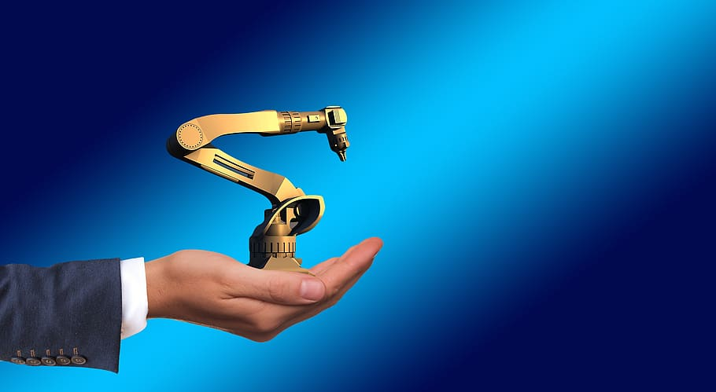
MexE 406
Robotics 1
Engr. Mikko A. De Torres
Mechatronics Engineer
Department of Electronics Engineering
Batangas State University || College of Engineering

Slide 2
“Introduction”
Engr. Mikko A. De Torres
Mechatronics Engineer
Department of Electronics Engineering
Batangas State University || College of Engineering

Slide 3
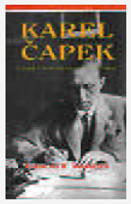
First Use of the Word ’Robot'
Acclaimed Czech playwright Karel Capek (1890-1938) made the first use of the word ‘robot.’
Czech word for forced labor or serf.

Slide 4
First Use of the Word ’Robot'
The word Robot was introduced into his play R.U.R.(Rossum's Universal Robots) which opened in Prague in January 1921.
Capek poses a paradise, where the machines initially bring so many benefits.
But in the end bring an equal amount of blight in the form of unemployment and social unrest.

Slide 5
R.U.R's Theme
Dehumanization of man in a technological civilization.
Robots were not mechanical in nature but were created through chemical means.
"It is with horror, frankly, that he rejects all responsibility for the idea that metal contraptions could ever replace human beings.”

Slide 6
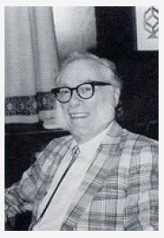
First Use of the Word ’Robotics'
First used in Runaround, a short story published in 1942 by Isaac Asimov.
“I, Robot,” a collection of several of these stories, was published in 1950.

Slide 7
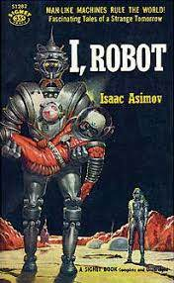
Asimov’s first robot
Asimov's fictional character - robotherapist.
Modern counterpart - Eliza.
Computer program for the study of natural language communication between man and machine.
Programmed to simulate a psychotherapist by answering questions with questions.

Slide 8
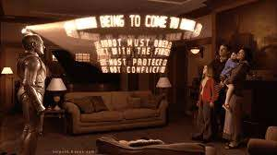
Three Laws of Robotics
Law Zero: A robot may not injure humanity, or, through inaction, allow humanity to come to harm.
Law One: A robot may not injure a human being, or, through inaction, allow a human being to come to harm, unless this would violate a higher order law.
Bicentennial Man (1999): Three Laws of Robotics

Slide 9
Three Laws of Robotics
Law Two: A robot must obey orders given it by human beings, except where such orders would conflict with a higher order law.
Law Three: A robot must protect its own existence as long as such protection does not conflict with a higher order law.
Bicentennial Man (1999): Three Laws of Robotics

Slide 10
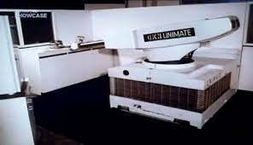
The First Robot 'Unimate'
After the technology explosion during World War II, in 1956, a historic meeting occurs between George C. Devol and Joseph F. Engelberger.
Discuss the writings of Isaac Asimov.
Commercially successful effort to develop a real, working robot.

Slide 11
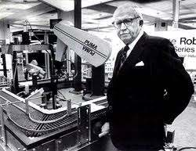
The First Robot 'Unimate'
Engelberger started a manufacturing company 'Unimation,’ universal automation.
First robot nicknamed the 'Unimate.'
Engelberger has been called the 'father of robotics.'

Slide 12
The First Robot 'Unimate'
The first Unimate was installed at a General Motors plant to work with heated die casting machines.
Perform spot welding on auto bodies.
Both applications were commercially successful, i.e., the robots worked reliably and saved money by replacing people.

Slide 13
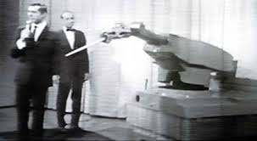
Unimation and Unimate
Other tasks performed by robots - loading and unloading machine tools.
Westinghouse acquired Unimation.
The robot idea was hyped to the skies and became high fashion in the Boardroom.

Slide 14
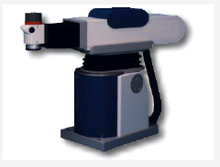
Modern Industrial Robots
Increased in capability and performance through controller and language development.
Improved mechanisms, sensing, and drive systems.

Slide 15
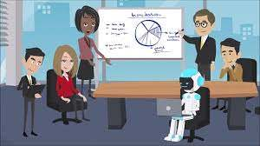
Benefits of Robots
Greatly reduce the costs of manufactured goods.
As a result of these industrial benefits, countries that effectively use robots in their industries that results to an economic advantage on world market.

Slide 16
“Definitions”
Engr. Mikko A. De Torres
Mechatronics Engineer
Department of Electronics Engineering
Batangas State University || College of Engineering

Slide 17
What is a Robot?
Robot Institute of America (1979)
A reprogrammable, multifunctional manipulator designed to move material, parts, tools, or specialized devices through various programmed motions for the performance of a variety of tasks.
Webster
An automatic device that performs functions normally ascribed to humans or a machine in the form of a human.

Slide 18
What is Robotics?
ISO 8373 (International Organization for Standardization)
"Robotics is an interdisciplinary branch of engineering and science that includes mechanical engineering, electrical engineering, computer science, and others. It deals with the design, construction, operation, and use of robots, as well as computer systems for their control, sensory feedback, and information processing."
IFR (International Federation of Robotics)
"Robotics is the science, technology, and application of robots, a type of mechatronics system that encompasses mechanical engineering, electrical engineering, computer science, and other related disciplines. Robotics involves the design, construction, operation, and use of robots, as well as the integration of robots into various applications, such as manufacturing, healthcare, logistics, and more."

Slide 19
ROBOTICS AND MECHATRONICS ENGINEERING
Robotics engineering
is a field of engineering which centers on building machines that replicate human actions.
Mechatronics engineering
integrates precision mechanical engineering with electronics, computer systems and advanced controls.
Notes:
Robotics Engineers from www.resources.workable.com
Mechatronics Engineers from www.itee.uq.edu.au

Slide 20
ROBOTICS AND MECHATRONICS ENGINEERING
Robotics engineering
keywords: “replicate human actions”
Mechatronics engineering
keywords: “integrates ”
a robot doesn’t always require an electromechanical part
a mechatronic system doesn’t always about designing a robot
Notes:
Robotics Engineers from www.resources.workable.com
Mechatronics Engineers from www.itee.uq.edu.au

Slide 21
ROBOTICS AND MECHATRONICS ENGINEERING
Robotics engineering
a subfield of mechatronics, however, are an elevated class of mechatronics
Mechatronics engineering
all robotics are mechatronics but not all mechatronics are robotics
Notes:
Robotics Engineers from www.engineering.queensu.ca
Mechatronics Engineers from www.engineering.queensu.ca

Slide 22
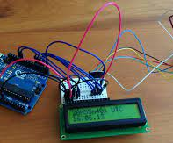
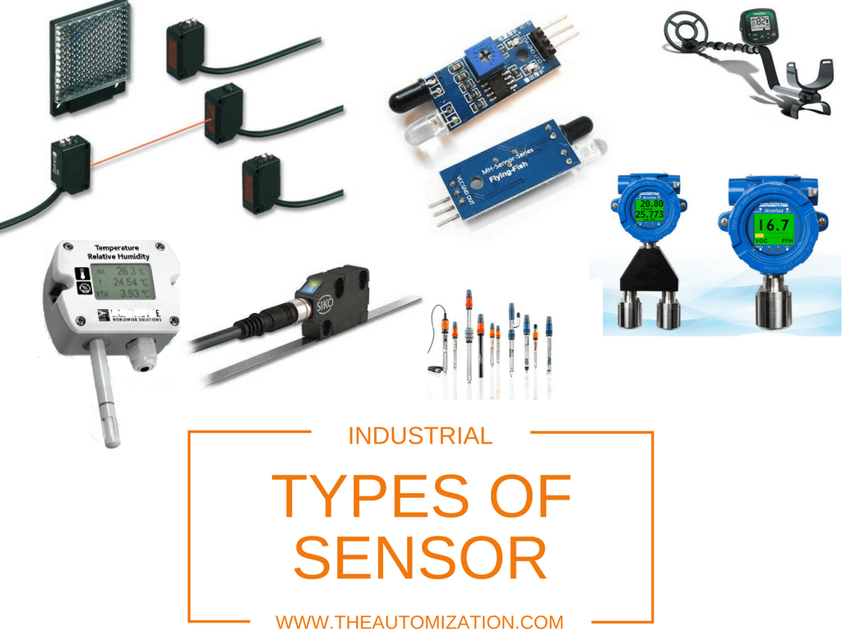
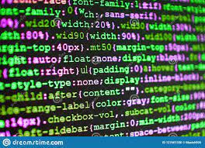
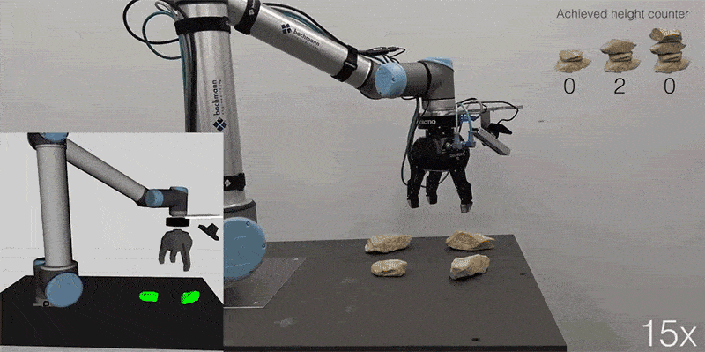
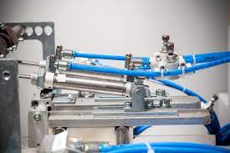
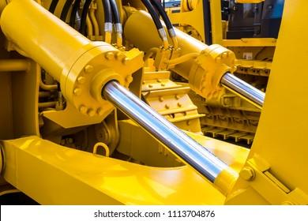
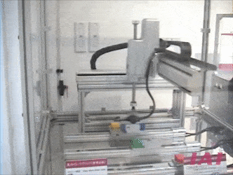
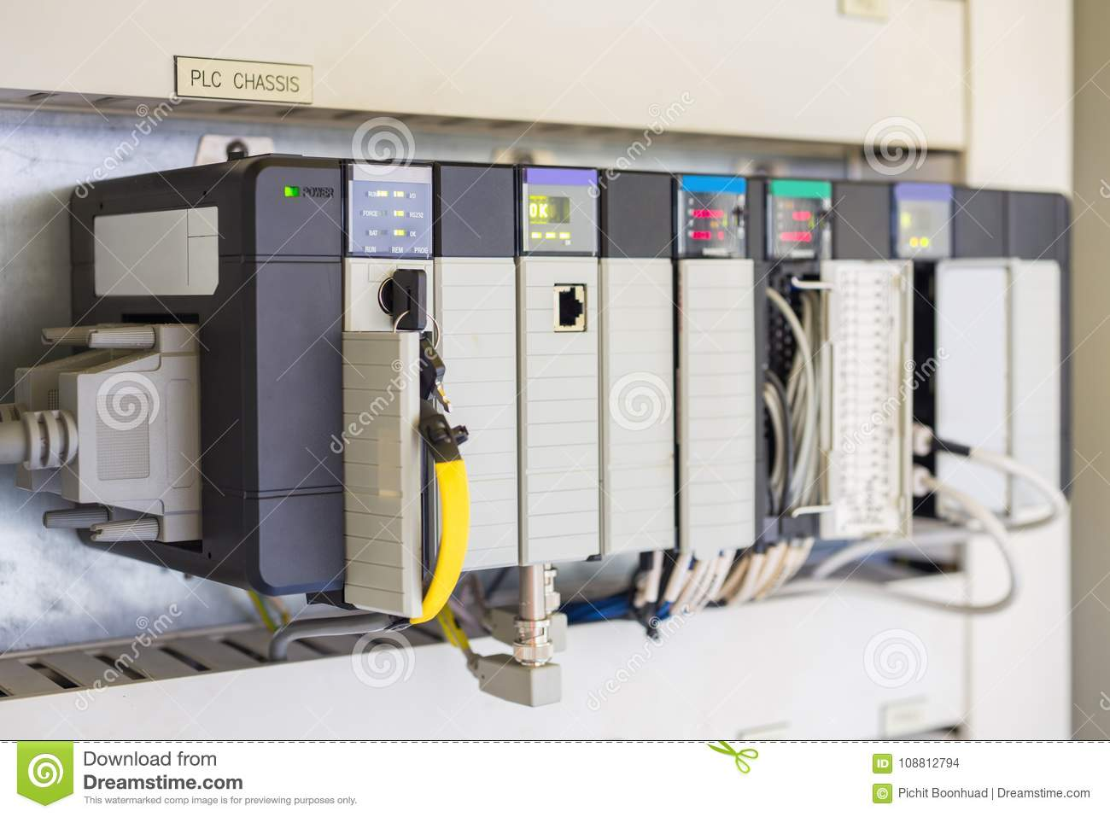
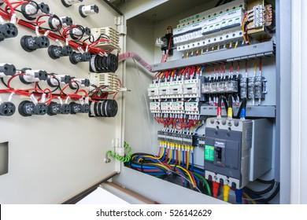

We will both doing robotics and mechatronics design.

Slide 23
“Types of Robotics”
Engr. Mikko A. De Torres
Mechatronics Engineer
Department of Electronics Engineering
Batangas State University || College of Engineering
Notes:
Hello again! . I'm your guide, Engr. Mikko De Torres, and in this video, we're delving into the heart of our journey. We'll explore the true meanings of Robotics and Mechatronics, and also clarify the distinctions between these two vital concepts. Let's jump right in!"

Slide 24
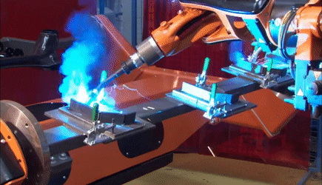
Types of Robotics
employs robots in manufacturing and industrial processes for tasks like assembling, welding, and material handling, enhancing productivity and precision
Industrial Robotics
Robotic Process Automation (RPA)
Mobile Robotics
Educational Robotics
Service Robotics
Social Robotics
Military Robotics
Agricultural Robotics

Slide 25

Types of Robotics
automates repetitive tasks in business processes using software robots or bots, commonly used in finance and customer service
Industrial Robotics
Robotic Process Automation (RPA)
Mobile Robotics
Educational Robotics
Service Robotics
Social Robotics
Military Robotics
Agricultural Robotics

Slide 26
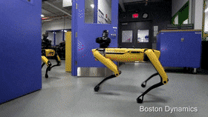
Types of Robotics
can navigate diverse environments, such as land, air, water, and even outer space, they're used for tasks like exploration, transportation, surveillance, and more
Industrial Robotics
Robotic Process Automation (RPA)
Mobile Robotics
Educational Robotics
Service Robotics
Social Robotics
Military Robotics
Agricultural Robotics

Slide 27
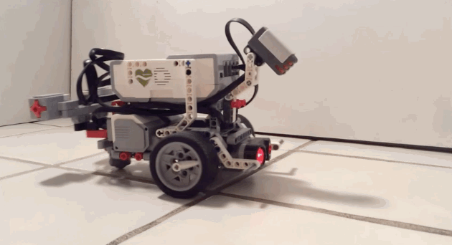
Types of Robotics
employs robots in educational settings to facilitate learning and skill development
Industrial Robotics
Robotic Process Automation (RPA)
Mobile Robotics
Educational Robotics
Service Robotics
Social Robotics
Military Robotics
Agricultural Robotics

Slide 28
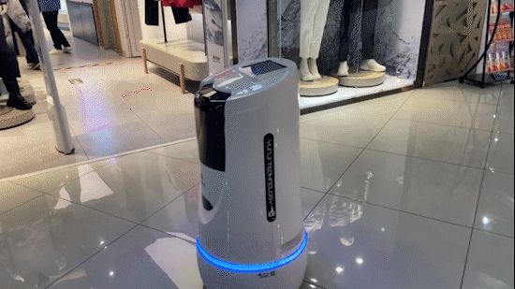
Types of Robotics
utilizes robots in service-oriented industries like healthcare and hospitality for tasks such as cleaning and patient care, incorporating sensors and AI for effective human interaction
Industrial Robotics
Robotic Process Automation (RPA)
Educational Robotics
Service Robotics
Social Robotics
Military Robotics
Agricultural Robotics

Slide 29
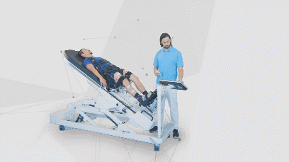
Types of Robotics
focuses on robots that interact with humans in social and emotional ways, used in applications such as therapy and companionship for people with disabilities
Industrial Robotics
Robotic Process Automation (RPA)
Educational Robotics
Service Robotics
Social Robotics
Military Robotics
Agricultural Robotics

Slide 30
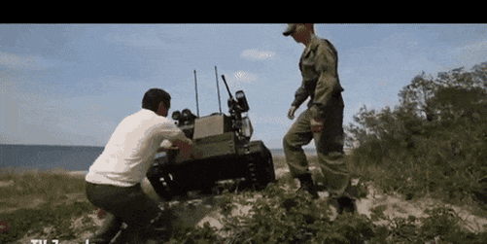
Types of Robotics
uses robots for military applications such as surveillance, reconnaissance, and bomb disposal, designed to operate in challenging environments and support military operations
Industrial Robotics
Robotic Process Automation (RPA)
Educational Robotics
Service Robotics
Social Robotics
Military Robotics
Agricultural Robotics

Slide 31
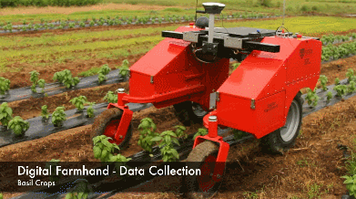
Types of Robotics
employs robots in farming and agriculture for tasks like planting, harvesting, and pest control, leveraging sensors and AI capabilities to optimize crop yield and reduce labor and chemical inputs
Industrial Robotics
Robotic Process Automation (RPA)
Educational Robotics
Service Robotics
Social Robotics
Military Robotics
Agricultural Robotics

Slide 32
“Mechatronics and Robotics”
Engr. Mikko A. De Torres
Mechatronics Engineer
Department of Electronics Engineering
Batangas State University || College of Engineering

Slide 33
"Jack of all trades, master of none." - Anonymous

Slide 34
"Jack of all trades, master of none, but oftentimes better than master of one." - Anonymous

Slide 35
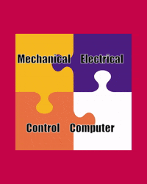
Integration is the Key

Slide 36
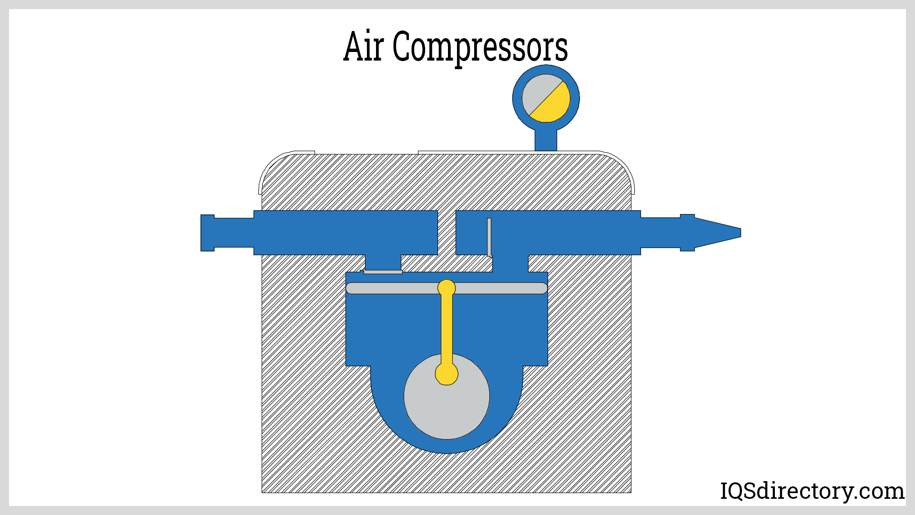
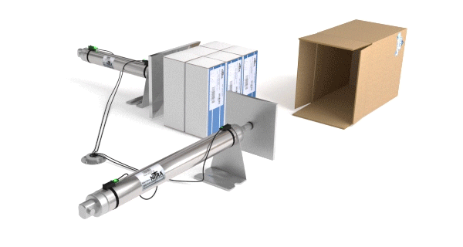
Integration: Mechanical
Actuator - Pneumatic Cylinders
Compressor

Slide 37
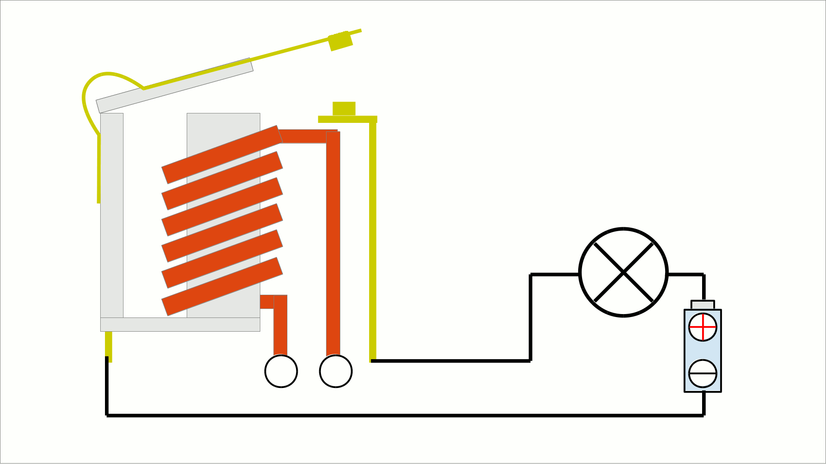
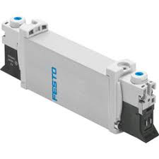
Integration: Electrical + Mechanical (Electromechanics)
Actuator - Pneumatic Cylinders
Compressor
Relay

Slide 38
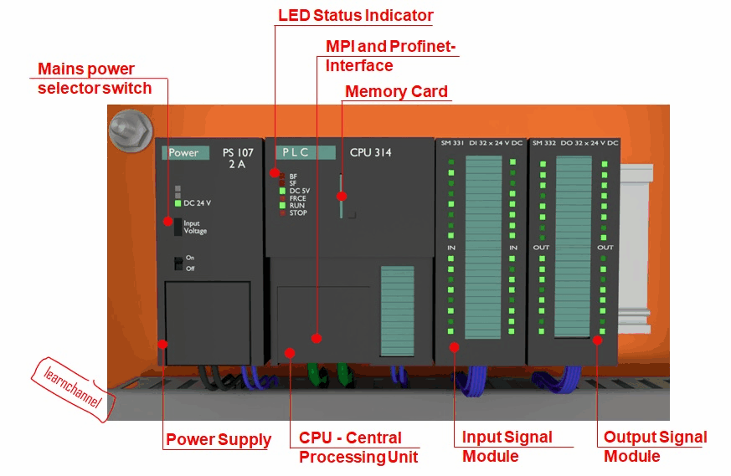
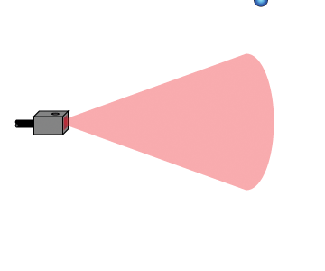
Integration: Electronics + Electromechanics
Actuator - Pneumatic Cylinders
Compressor
Relay
PLC
Sensor

Slide 39
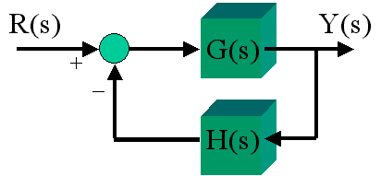
Integration: Controls + Electronics + Electromechanics
Relay
Actuator - Pneumatic Cylinders
Compressor
PLC
Sensor
Sensor
Control System Engineering

Slide 40

Integration: Computer Systems to Controls + Electronics + Electromechanics
Relay
Actuator - Pneumatic Cylinders
Compressor
PLC
Sensor
Sensor
Computer Systems
Control System Engineering

Slide 41
Mechatronics
Relay
Actuator - Pneumatic Cylinders
Compressor
PLC
Sensor
Sensor
Computer Systems
Control System Engineering

Slide 42
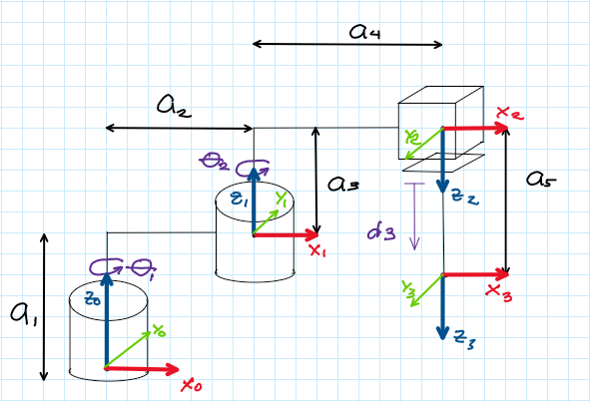
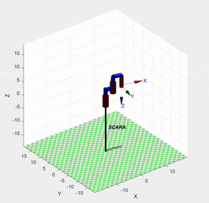
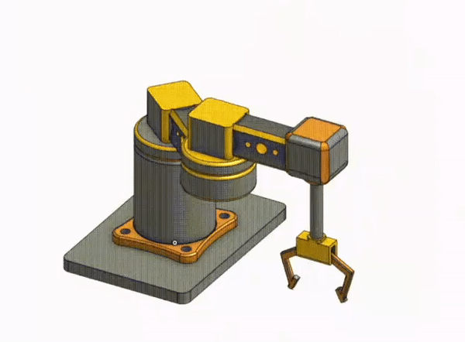
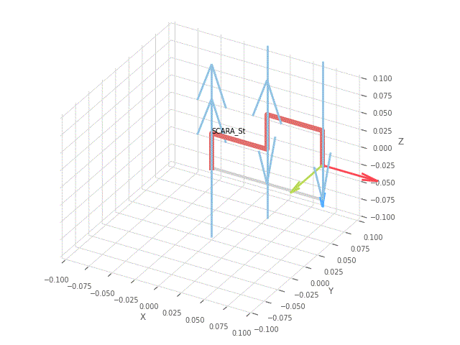
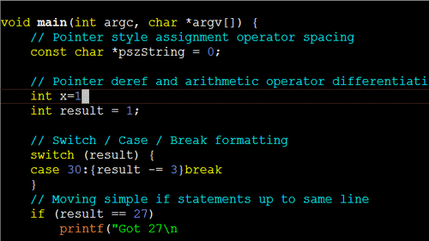

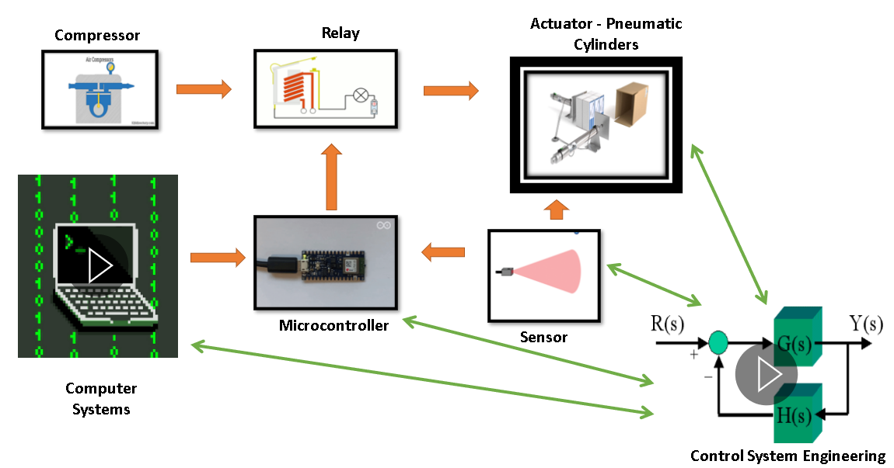
Mechatronics → Robotics
Simulation
Kinematics and Dynamics
Math-based Robot Programming
Path and Trajectory
Integration

Slide 43
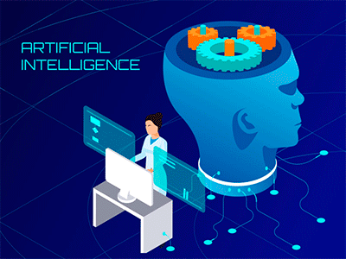
Mechatronics → Robotics + AI
Simulation
Kinematics and Dynamics
Math-based Robot Programming
+
Path and Trajectory
Integration

Slide 44
“Misconceptions”
Engr. Mikko A. De Torres
Mechatronics Engineer
Department of Electronics Engineering
Batangas State University || College of Engineering

Slide 45
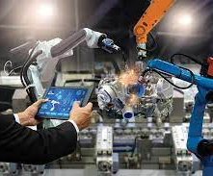
ROBOT CREATE JOBS
Disadvantage of Robots: Robots are dumb but their creators are smart businessmen.
Example of jobs:
QA Inspectors
Engineers
Technologists / Technicians
Scientists
Admin Staff
Safety Officers
5S Officers and Auditors
Entrepreneurs
Trainers/ Teachers

Slide 46
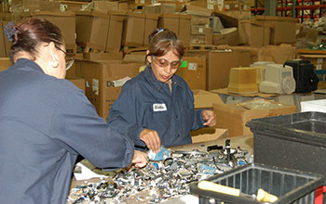
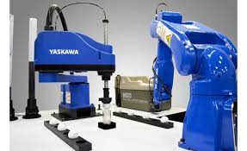
OVEREXERTION
Overexertion is a primary cause of workplace injuries, accidents and illnesses.
Robots are designed based from the idea that to improve work safety, jobs that may cause injury, illness or accident should be done by a robot.

Slide 47
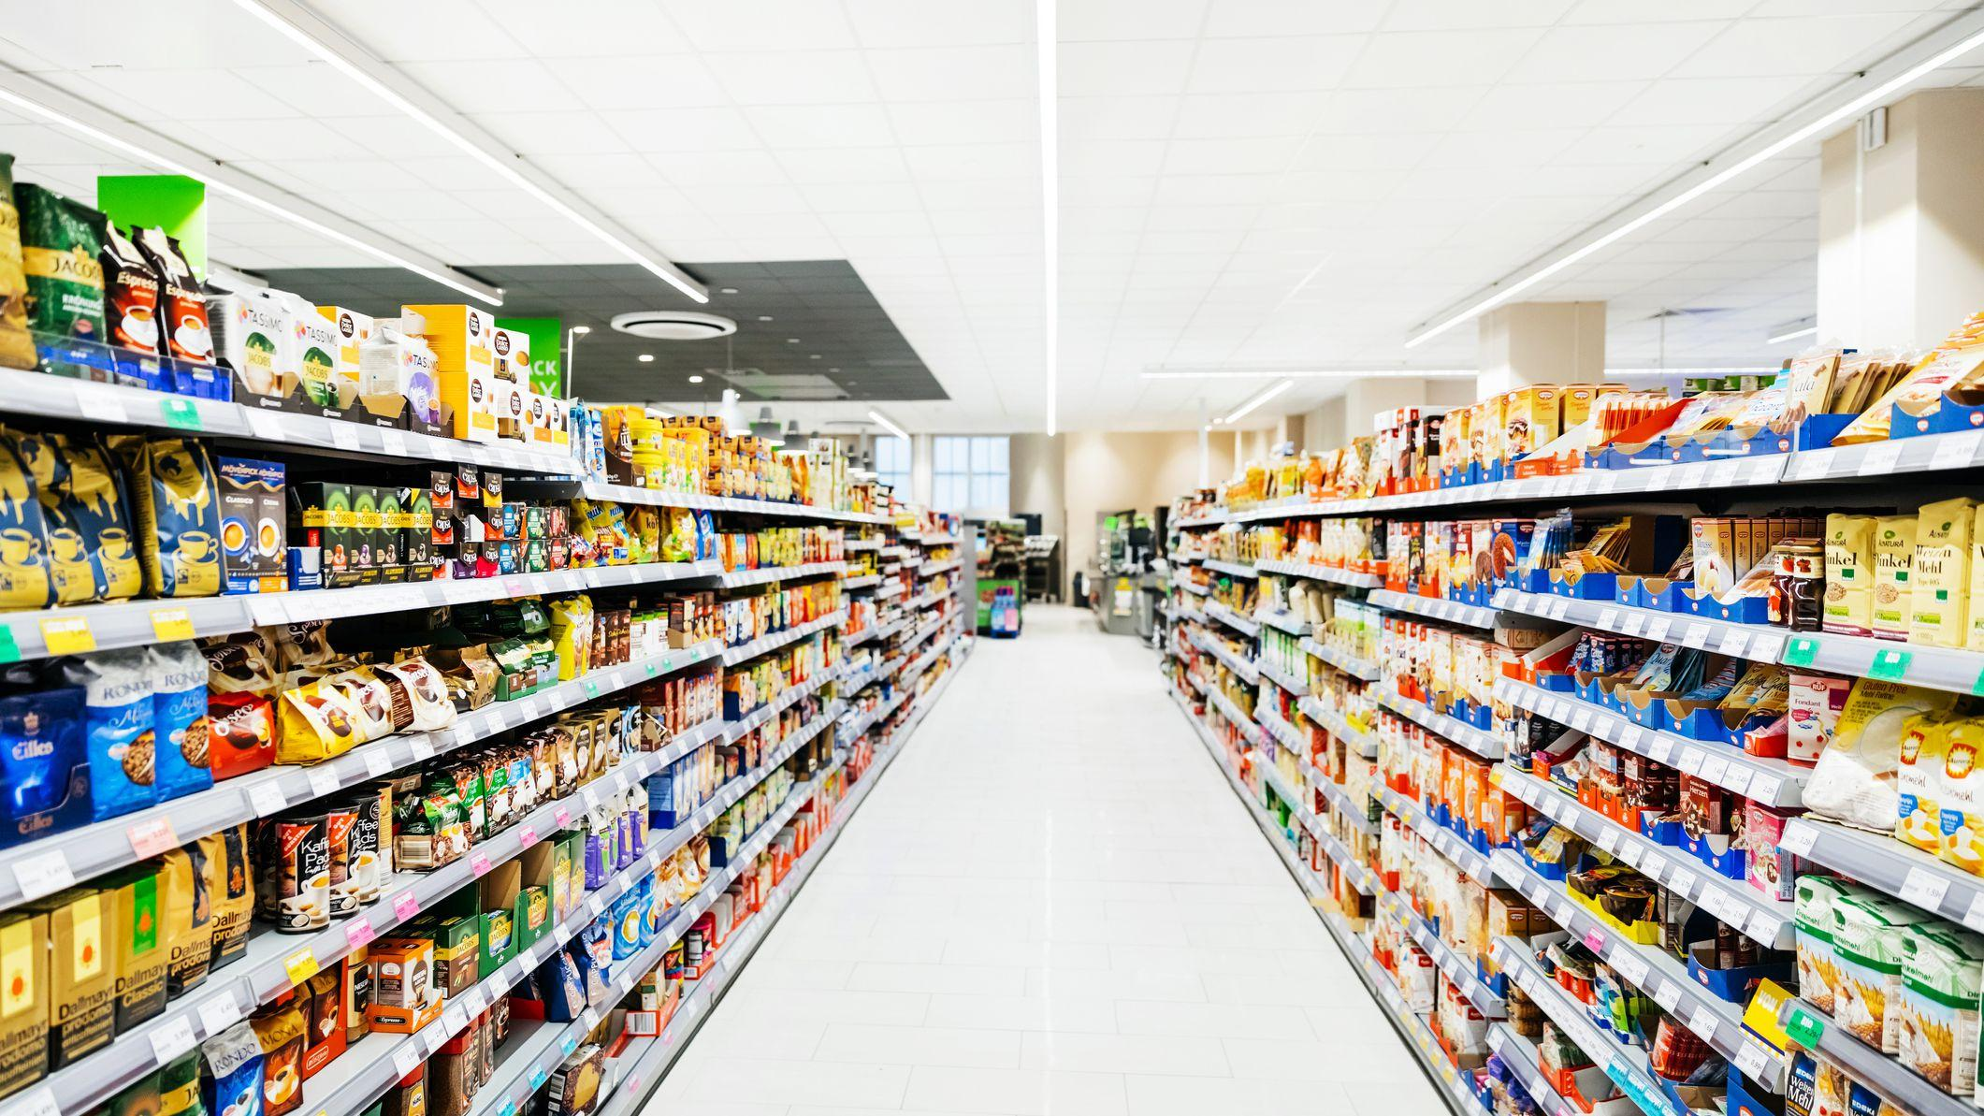
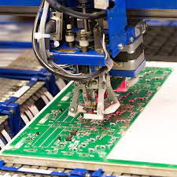
LOW COST OF MANUFACTURED PRODUCTS

Slide 48
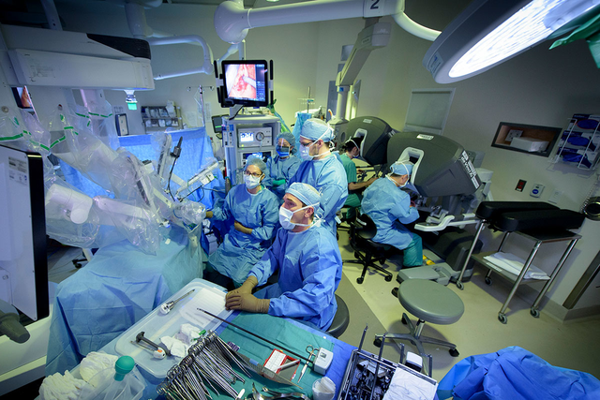
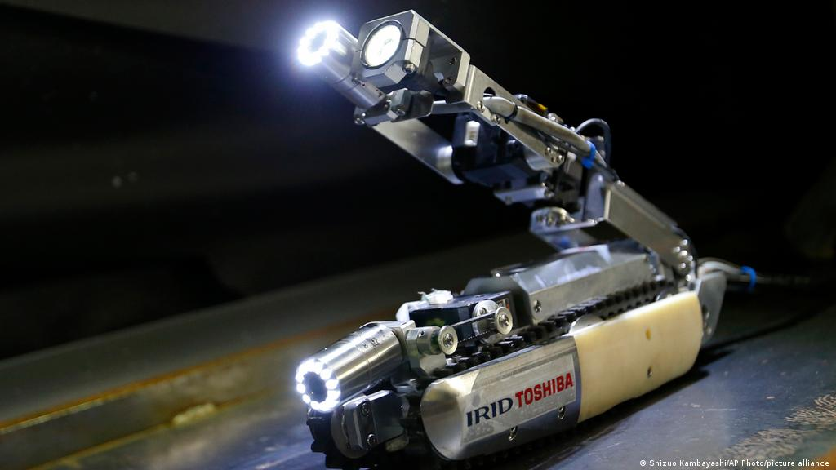
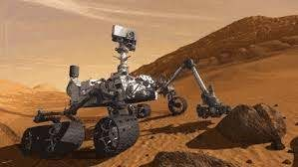
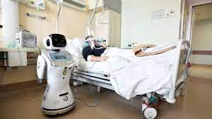
ROBOT SAVE LIVES

Slide 49
“Advance Concepts”
Engr. Mikko A. De Torres
Mechatronics Engineer
Department of Electronics Engineering
Batangas State University || College of Engineering

Slide 50


MECHANICAL MANIPULATOR KINEMATIC DIAGRAM WITH JOINT VARIABLE LABELS, LINK LABELS AND ASSIGNED D-H FRAMES
The ‘cylinders ‘are the revolute joints or the motor actuator joints.
The ‘cubes’ are the prismatic joints or it can be either pneumatic cylinders, rod less cylinders or any translating joints.
The ‘cartesian systems’ are the frames. They indicate the orientation and position of the manipulator’s part.
The ‘Θs’ and ‘ds ‘are the joint variables.
The ‘a’ are the link lengths.
Articulated Manipulator
Cartesian Manipulator

Slide 51


D-H PARAMETRIC TABLE
Articulated Manipulator
‘Θ’ is the rotation around the Zn-1 to match Xn-1 to the direction of Xn, with the joint variable Θn if joint is revolute/twisting.
‘α’ is the rotation around Xn to match Zn-1 to Zn direction.
‘d’ is the distance from the origin of frame n-1 to the origin of frame n along the Zn-1 direction with the joint variable dn if joint is prismatic.
‘r’ is the is the distance from the origin of frame n-1 to the origin of frame n along the Xn direction.
Cartesian Manipulator

Slide 52

HOMOGENEOUS TRANSFORMATION MATRIX

Slide 53

ROBOT KINEMATICS
Kinematics is the Science of motion which treats motion without considering the forces which causes the motion.
Forward Kinematics is the geometrical problem of computing the position vector and orientation of the end-effector given the joint variables.
Inverse Kinematics is the geometrical problem of computing the joint variables given the end- effector position vector.

Slide 54


INVERSE KINEMATICS: GRAPHICAL METHOD

Slide 55
ROBOTIC TOOLBOX BY PETER CORKE
The toolbox contains functions and classes to represent orientation and pose in 2D and 3D (SO(2), SE(2), SO(3), SE(3)) as matrices, quaternions, twists, triple angles, and matrix exponentials. The Toolbox also provides functions for manipulating and converting between datatypes such as vectors, homogeneous transformations and unit-quaternions which are necessary to represent 3-dimensional position and orientation.

Slide 56
Thank you for listening!

